Slide 1



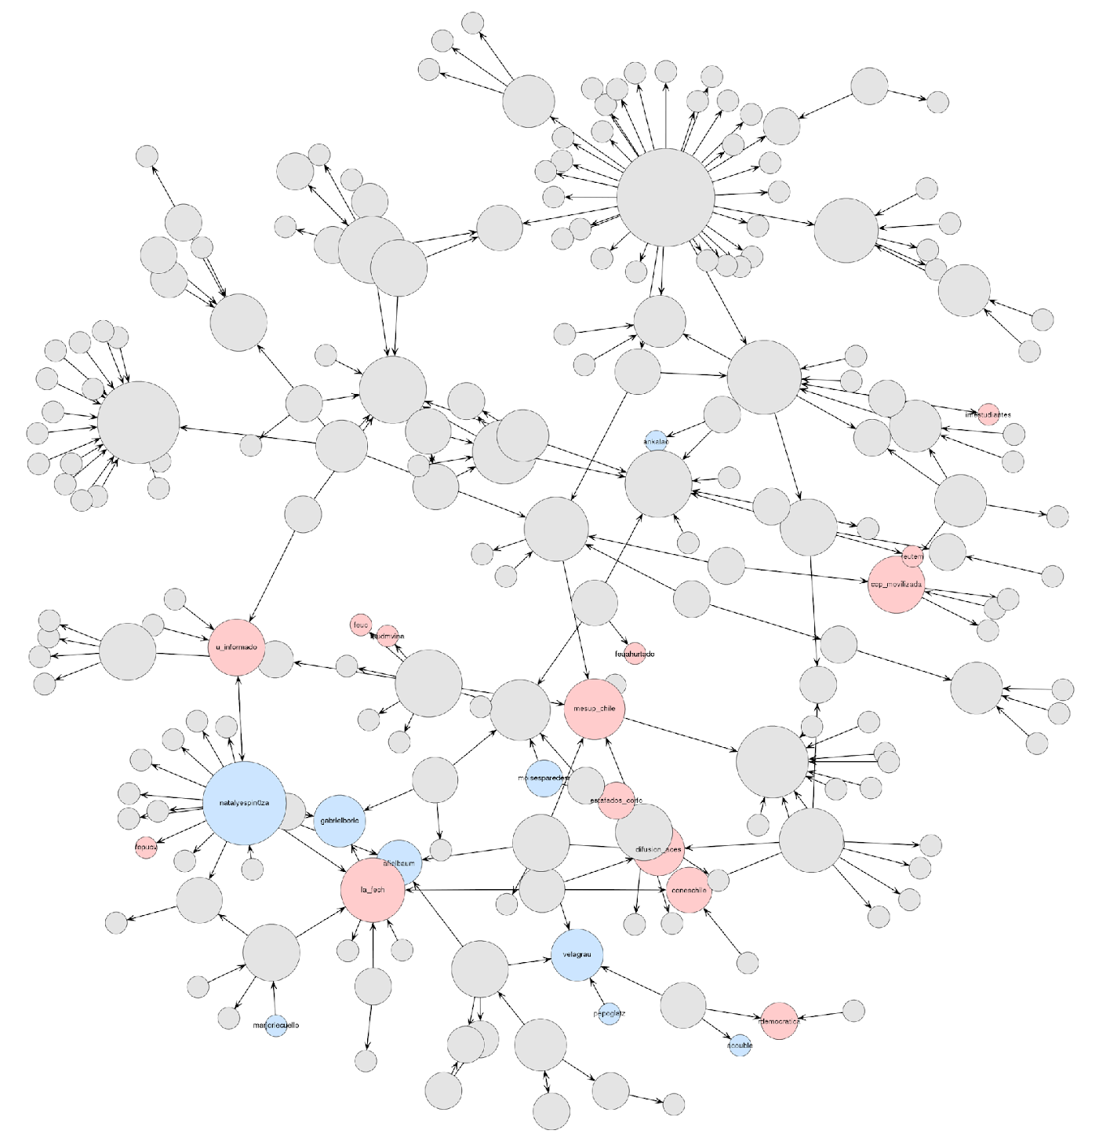
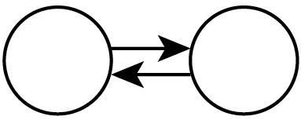
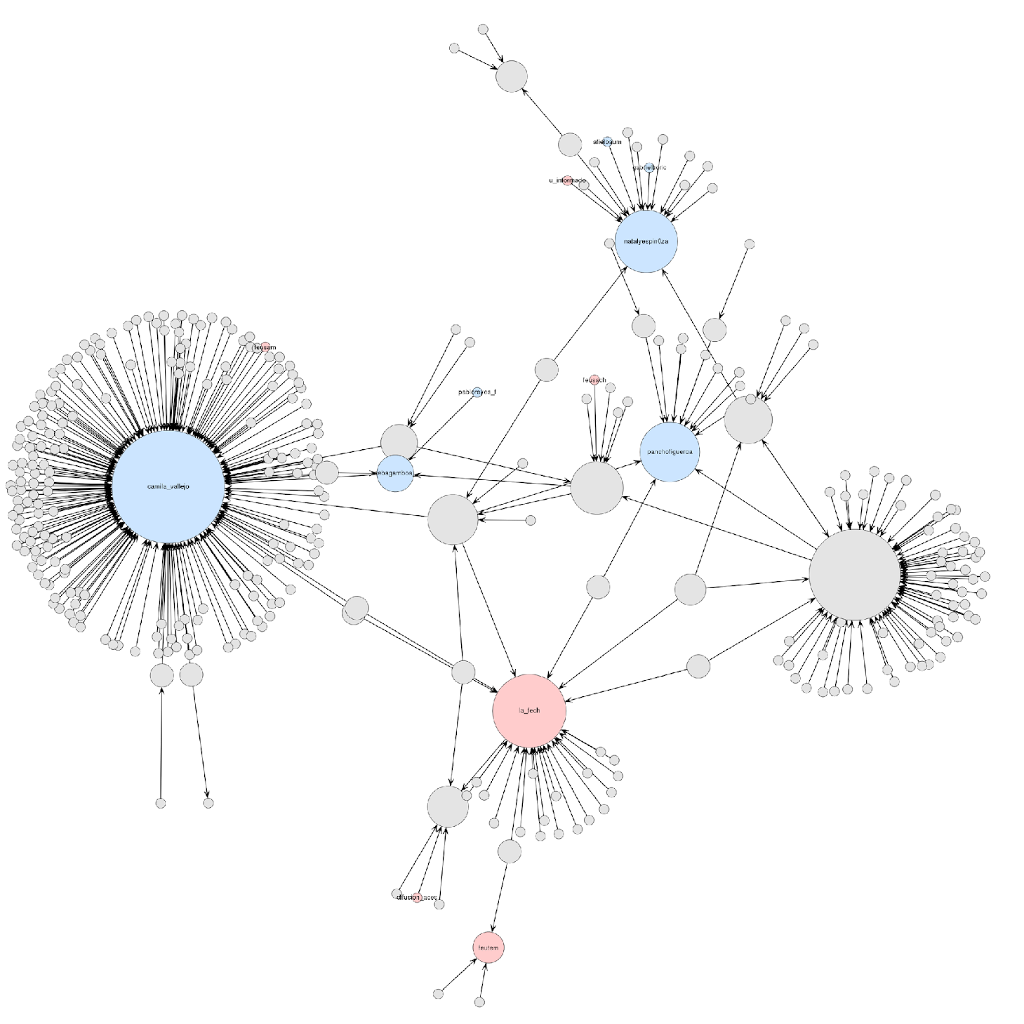
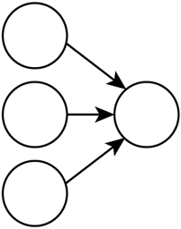
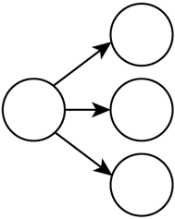
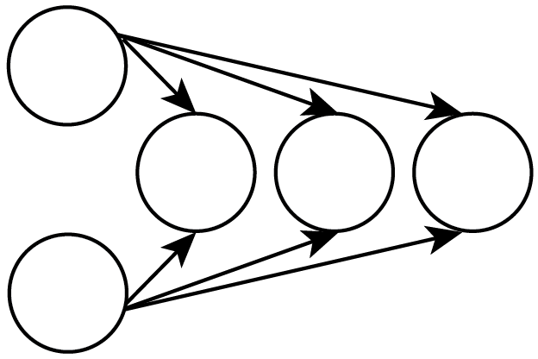
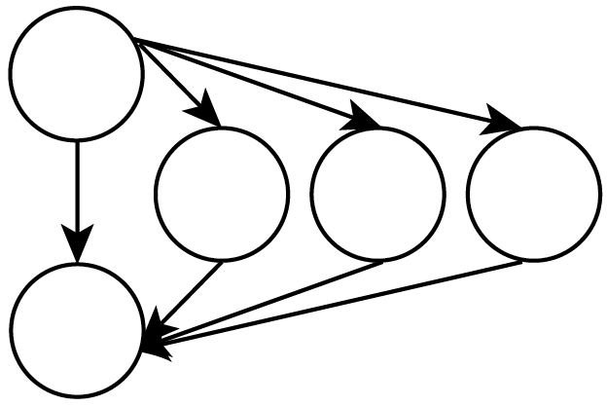
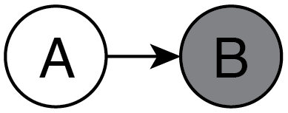
The role of social movement organizations and their leaders in Twitter: Evidence from the Chilean Student Movement
Diego Gomez-Zara^{1,2}, Denis Parra², Cristobal García², and Noshir Contractor¹
1. Northwestern University, 2. Pontificia Universidad Católica de Chile.
Motivation
Methodology
Results
Analysis
To study how social movement organizations (SMOs) and their leaders differentiated from each other in Twitter.
To examine how their social media accounts use disparate communications strategies
Data Collection
We examined four hashtags and tracked their mentions on Twitter: #YoMarchoEl28, #YoMarchoEl25, #YoMarchoEl11, and #YoApoyoALosEstudiantes.
We collected a dataset of 88,870 tweets and identified 34,471 users using Topsy Pro Analytics.
We classified Twitter accounts into three distinct sets: Student Organizations, Student Leaders, and People.
Types of Networks
“Informational Network”: for each hashtag, this network contains all the retweets made by users and included the hashtag in their text.
“Conversational Network”: it contains all the mentions and replies made by users and including its respective hashtag.
Exponential Random Graph Models (ERGM)
We test if one or more social structures are more prevalent in the network than would occur by chance alone.
The parameters of network configurations explain the extent of a specific pattern in a determined network.
A positive value indicates that the pattern will be more likely than expected.
A zero value indicates that the pattern is not present in the network.
A negative value represents that the pattern will happen less than expected.
ERGM Informational Network
A small group of users was the source of the majority of the retweets, and most users addressed their replies and mentions to a small group of accounts.
This pattern reflects the high popularity of certain actors, as well the preferential attachment pattern present in social networks mostly.
Also, most of conversations were established by a small group of users.
Both networks present more triangles structures than expected by chance. Earlier retweeted users have more chances to be retweeted again.
Leaders had 88% more chances than the expected to be retweeted by people, while organizations had 51%.
SMOs were more mentioned or replied than leaders (186% against 78% more chances to be replied/mentioned than the expected).
N = 4 hashtags, 1,077 user accounts, 1,382 edges; MLE Log likelihood: 85,924.56 (d.f.=14)
Controls | Estimate (SD) | Odds-ratio
Structure Effects
Edges | -4.97 (0.07) *** | 0.01
Reciprocity | 0.33 (0.41) | 1.39
Geometric Weighted In-degree | -6.71 (0.18) *** | 0
Geometric Weighted Out-degree | 2.7 (0.13) *** | 14.89
Geometric Weighted Edge Shared Partners (GWESP) | 1 (0.09) *** | 2.71
Geometric Weighted Dyad Shared Partners (GWDSP) | 0.04 (0.01) *** | 1.04
Actor Attributes
Leader to Leader | -1.82 (0.54) *** | 0.16
Organization to Leader | -0.68 (0.61) | 0.51
People to Leader | 0.63 (0.05) *** | 1.88
Leader to Organization | -0.32 (0.43) | 0.72
Organization to Organization | 0.22 (0.52) | 1.24
People to Organization | 0.41 (0.06) *** | 1.51
Leader to People | -1.91 (0.37) *** | 0.15
Organization to People | 0.27 (0.27) | 1.31
Introduction
Emerging social movements face new communications environments to promote their goals, expand their ideologies, and work for social change. Social Movement Organizations (SMOs) and their leaders must master several tasks to meet these challenges. As digital technologies mediate communications in modern society, SMOs and their leaders must lead new digital communication strategies to interact with their audiences. Under this context, digital interfaces shape the discourse between SMOs and their audiences, leading to the creation of new identities and communication strategies
ERGM Conversational Network
N = 4 hashtags, 831 user accounts, 1,031 edges; MLE Log likelihood: 64,685.67 (d.f.=14)
Controls | Estimate (SD) | Odds-ratio
Structure Effects
Edges | -4.77 (-4.77) *** | 0.01
Reciprocity | 2.07 (2.07) *** | 7.93
Geometric Weighted In-degree | -0.44 (-0.44) *** | 0.65
Geometric Weighted Out-degree | -1.58 (-1.58) *** | 0.21
Geometric Weighted Edge Shared Partners (GWESP) | 0.91 (0.91) *** | 2.47
Geometric Weighted Dyad Shared Partners (GWDSP) | 0.02 (0.02) ** | 1.02
Actor Attributes
Leader to Leader | 0.73 (0.73) *** | 2.07
Organization to Leader | 0.94 (0.94) *** | 2.55
People to Leader | 0.58 (0.58) *** | 1.78
Leader to Organization | 0.51 (0.51) . | 1.67
Organization to Organization | 0.38 (0.38) | 1.46
People to Organization | 1.05 (1.05) *** | 2.86
Leader to People | 0.02 (0.02) | 1.02
Organization to People | -0.84 (-0.84) *** | 0.43
Conclusion
Example of
Conversational
Network
(mentions and replies)
SMOs and their leaders represent different ways of exercising social influence, resulting in their recognition by common users.
SMOs’ reputation accounts would last on time, while protest leaders could rise their popularity or have less importance after finishing their governance period.
SMOs have evolved in digital environments by establishing authentic dialogs with their audiences.
Name | Visual representation | Description
Reciprocity |  | Number of pairs of actors A and B for which (A→B) and (B→A) both exist.
Geometric weighted in-degree distribution |  | The weighted in-degree distribution of the network with a decay parameter.
Geometric weighted out-degree distribution |  | The weighted out-degree distribution of the network with a decay parameter.
Geometric weighted dyadwise shared partner distribution. |  | Distribution of shared partners for all the dyads in the network.
Geometric weighted edgewise shared partner distribution. |  | Distribution of shared partners that two nodes connected by an edge has in the network.
Nodal attribute mixing. |  | Number of edges in the network in which the nodes have a specific pairing with people, leaders, or organizations.
Example of
Informational Network
(retweeets)
Acknowledgements
People
Organizations
This research was supported by grants from the
CONICYT research agency, Grant Fondecyt/11150783 and
Army Research Office W911NF-14-10686
Leaders

